Slide 1
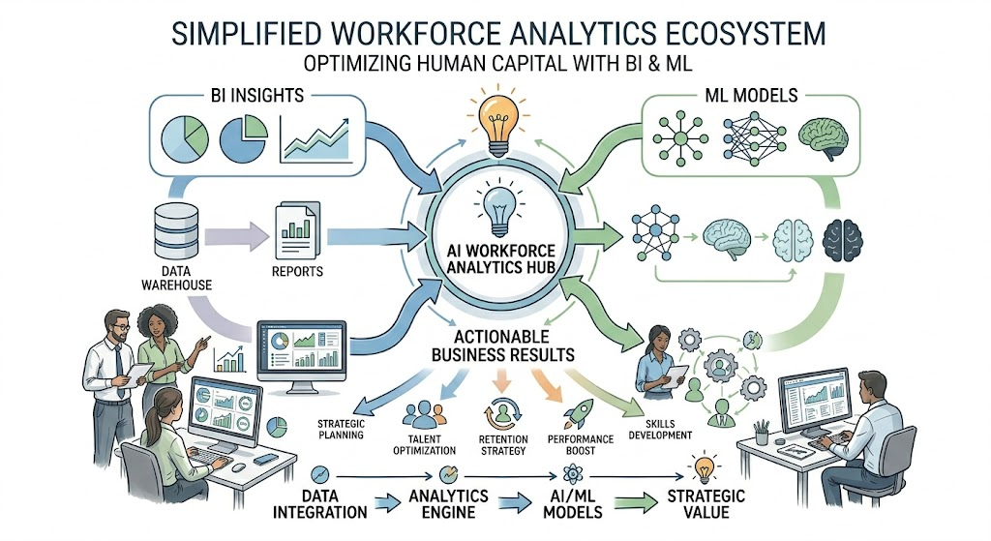

Slide 2


Problem
Organizations face challenges in understanding how AI adoption affects employees, including burnout, satisfaction, productivity, and attrition risk.
Goals & Objectives
Goal
Use Business Intelligence and Machine Learning to analyze workforce behavior and predict employee attrition risk.
Project Objectives
Analyze employee behavior and workforce performance.
Identify factors affecting attrition risk.
Predict employee attrition using machine learning.
Segment employees using clustering.
Develop interactive Power BI dashboards.
Support data-driven HR decision-making.

Slide 3
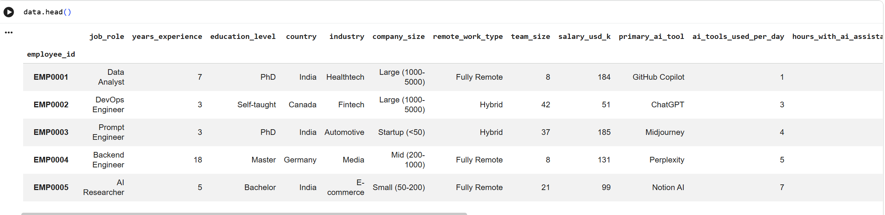
Dataset Source
Kaggle – AI Impact on the Workplace Dataset
Dataset Description
The dataset contains employee and workplace information related to AI adoption, employee satisfaction, burnout, productivity, salary, work environment, and attrition risk. It was used to analyze the impact of artificial intelligence on workforce performance and employee retention through Business Intelligence and Machine Learning techniques.
Dataset Size
Approximately 1500 employee records
Contains demographic, organizational, AI adoption, productivity, satisfaction, burnout, and attrition-related variables.

Slide 4
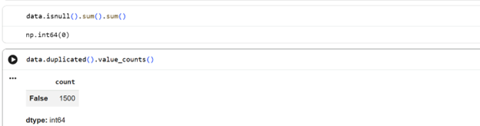
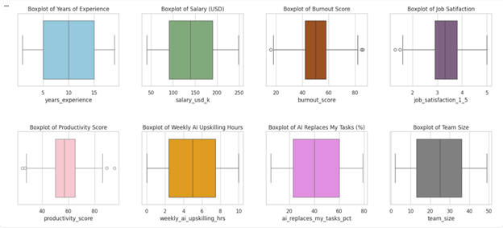
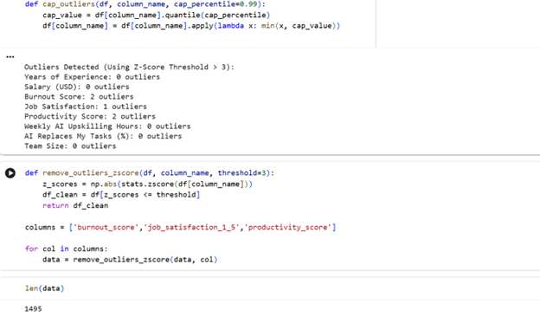
Data Cleansing
Before analysis and modeling, the dataset was cleaned to ensure data quality.
Missing Values: No missing values were found.
Duplicates: No duplicate records were detected.
Outlier Detection: Boxplots and Z-Score analysis were used to identify extreme values.
Outlier Removal: A small number of outliers in burnout, productivity, and job satisfaction were removed.
Result
Original Records: 1,500
Cleaned Records: 1,495
The cleaned dataset was then used for dashboard development, machine learning models, and clustering analysis.

Slide 5
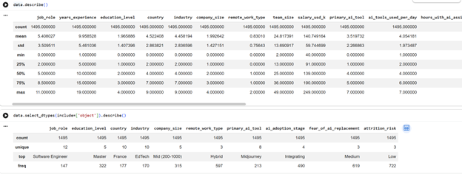
Descriptive Statistics
Numerical Variables
Analysis of 1,495 employee records showed:
Average experience: 10 years
Average salary: 140K USD
Average team size: 25 employees
Salary ranges from 40K to 249K USD
Team sizes range from 2 to 49 employees
Insight: The workforce contains employees with diverse experience levels, salaries, and team structures.
Categorical Variables
The dataset includes:
12 Job Roles
10 Countries
10 Industries
4 AI Adoption Stages
Most common categories:
Software Engineer (Job Role)
Hybrid (Remote Work Type)
Integrating (AI Adoption Stage)
Medium (Fear of AI Replacement)
Insight: Hybrid work and AI integration are common across the workforce.

Slide 6
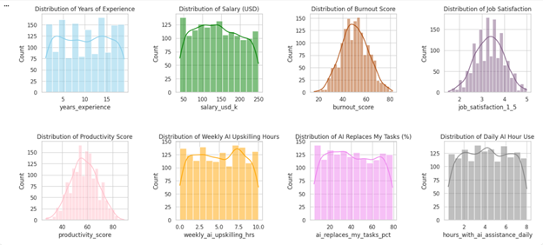
Distribution Analysis
Years of Experience: Employees have varying experience levels, with a slight concentration in mid-level experience.
Business Value: Helps assess workforce maturity and performance trends.
Salary (USD): Salaries are distributed across different income levels.
Business Value: Supports compensation and employee satisfaction analysis.
Burnout Score: Burnout levels follow a near-normal distribution centered around moderate levels.
Business Value: Identifies workforce well-being and potential attrition risks.
Job Satisfaction: Most employees report medium to high satisfaction.
Business Value: Measures employee engagement and workplace morale.
Productivity Score: Productivity is concentrated around average performance levels.
Business Value: Supports workforce performance evaluation.
Weekly AI Upskilling Hours: Employees spend varying amounts of time developing AI skills.
Business Value: Measures readiness for AI transformation.
AI Replaces My Tasks (%): Employees have different perceptions of AI replacing job tasks.
Business Value: Helps understand AI-related concerns and workforce sentiment.
Daily AI Tool Usage: AI usage is fairly distributed among employees.
Business Value: Evaluates AI adoption and its impact on work performance.

Slide 7
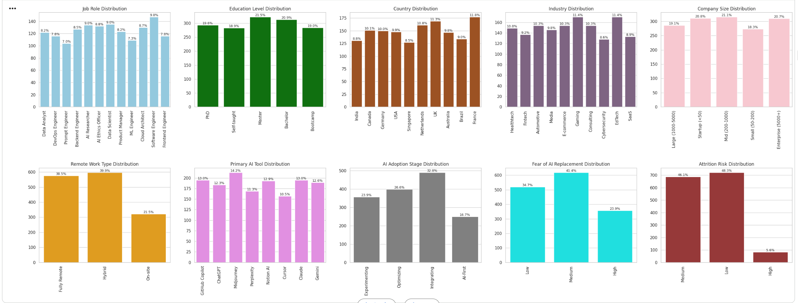
Distribution Analysis
Job Role Distribution: Software Engineer has the highest percentage, while some technical roles appear slightly lower. Business Use: Helps analyze workforce structure across AI-related jobs.
Education Level Distribution: Most employees hold Master’s or Bachelor’s degrees. Business Use: Helps evaluate workforce qualification levels. Country Distribution: Employees are distributed across multiple countries, with France and the UK slightly higher. Business Use: Enables geographic workforce analysis. Industry Distribution: Gaming and EdTech industries have higher representation. Business Use: Identifies industries more engaged in AI transformation. Company Size Distribution: Mid-size and Enterprise companies appear most represented. Business Use: Helps compare AI adoption across company sizes. .
Remote Work Type Distribution: Hybrid and Fully Remote work dominate the dataset. Business Use: Evaluates the effect of work style on employees.
Primary AI Tool Distribution: Midjourney and GitHub Copilot are among the most used tools. Business Use: Identifies commonly adopted AI technologies.
AI Adoption Stage Distribution: Most companies are in the Integrating stage. Business Use: Measures AI implementation maturity.
Fear of AI Replacement Distribution: Medium fear is the most common level among employees. Business Use: Helps organizations measure employee AI concerns.
Attrition Risk Distribution: Most employees fall under Low or Medium attrition risk. Business Use: Helps evaluate workforce retention stability.

Slide 8
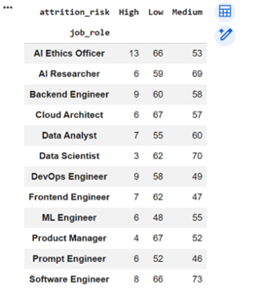
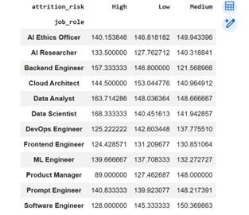
Pivot Tables
Attrition Risk by Job Role
Most job roles have a higher number of employees in the Low and Medium attrition risk categories.
Software Engineers have the largest workforce and the highest number of Medium-risk employees.
Data Scientists and AI Researchers also show relatively high Medium attrition risk levels.
High-risk employees represent a smaller portion across all job roles.
Business Use: Identifies job roles that may require additional retention efforts and employee support.
Average Salary by Attrition Risk and Job Role
Employees with High attrition risk generally have higher average salaries in several roles.
Data Scientists and Cloud Architects show some of the highest average salaries among high-risk employees.
Low-risk employees tend to have more stable salary distributions across roles.
Business Use: Helps determine whether compensation alone is sufficient to retain employees and highlights roles where other factors may drive attrition.

Slide 9
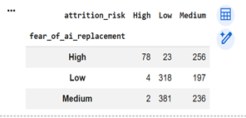
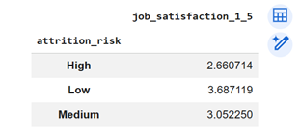
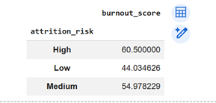
Pivot Tables
Fear of AI Replacement by Attrition Risk
Employees with High fear of AI replacement have significantly more Medium and High attrition risk cases, while employees with Low or Medium fear are more likely to fall under Low attrition risk.
Business Use: Helps organizations assess how concerns about AI adoption influence employee retention and workforce stability.
Job Satisfaction by Attrition Risk
Employees with Low attrition risk have the highest average job satisfaction score (3.69), while employees with High attrition risk have the lowest satisfaction level (2.66).
Business Use: Measures how employee satisfaction influences retention and engagement.
Burnout Score by Attrition Risk
Employees with High attrition risk have the highest average burnout score (60.5), while employees with Low attrition risk have the lowest burnout level (44.03).
Business Use: Helps identify burnout as a potential driver of employee turnover.

Slide 10
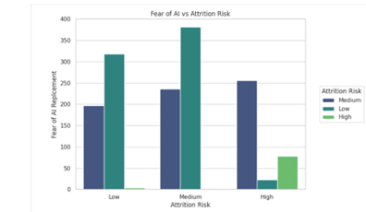
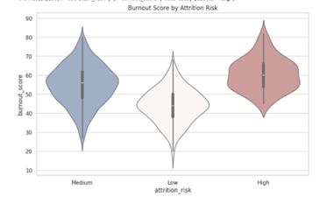
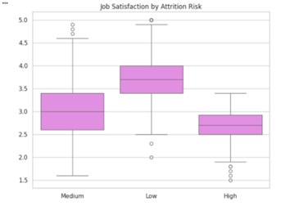
Charts…
Fear of AI Replacement vs Attrition Risk
The chart shows a clear relationship between fear of AI replacement and attrition risk. Employees with High fear of AI replacement are more likely to have Medium or High attrition risk, while employees with Low fear are predominantly associated with Low attrition risk.
Business Use: Helps organizations understand how employee concerns about AI adoption impact workforce retention and supports better communication, training, and change management strategies.
Burnout Score by Attrition Risk
The violin plot illustrates the distribution of burnout scores across attrition risk levels. Employees with High attrition risk exhibit the highest burnout levels, while employees with Low attrition risk show noticeably lower burnout scores.
Business Use: Helps organizations identify burnout as a key workforce challenge and supports employee wellbeing and retention initiatives.
Job Satisfaction by Attrition Risk
The boxplot shows that employees with Low attrition risk have the highest job satisfaction levels, while employees with High attrition risk report the lowest satisfaction scores.
Business Use: Helps organizations evaluate how employee satisfaction influences retention and supports initiatives aimed at improving engagement and workplace experience.

Slide 11
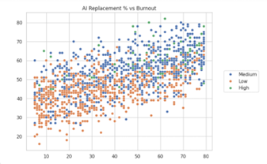
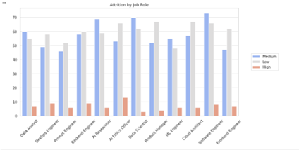
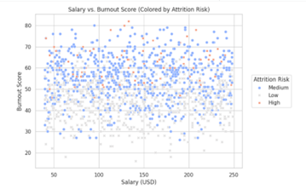
Charts…
AI Replacement % vs Burnout Score The scatter plot shows a positive relationship between the percentage of tasks employees believe AI can replace and their burnout scores. Employees who perceive higher levels of AI replacement generally report higher burnout levels. High attrition risk employees are more concentrated in the upper burnout range.
Business Use: Helps organizations understand how AI-related concerns may impact employee wellbeing and identify employees who may require additional support during AI transformation initiatives.
Attrition Risk by Job Role The chart compares attrition risk across different job roles. Most roles are dominated by Low and Medium attrition risk employees, while High attrition risk remains relatively low. Software Engineers, Data Scientists, and AI Researchers show higher employee counts overall.
Business Use: Helps organizations identify workforce segments that may require targeted retention programs and workforce planning strategies.
Salary vs Burnout Score The scatter plot shows the relationship between employee salary and burnout score across different attrition risk levels. Burnout levels vary widely at all salary ranges, indicating that higher salaries do not necessarily reduce burnout. Employees with Medium and High attrition risk are present across nearly all salary levels.
Business Use: Helps organizations recognize that compensation alone may not address employee burnout and that additional wellbeing initiatives may be required.

Slide 12
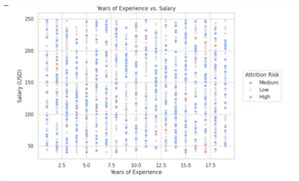
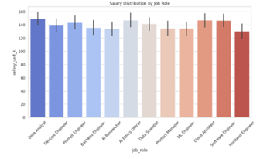
Charts…
Years of Experience vs Salary The scatter plot illustrates the relationship between years of experience and salary across different attrition risk levels. Salaries are distributed across all experience levels, with Medium attrition risk employees representing the largest group. Higher experience does not always correspond to lower attrition risk.
Business Use: Helps organizations evaluate compensation patterns based on employee experience and assess whether salary growth supports workforce retention.
Salary Distribution by Job Role The bar chart compares average salaries across different job roles. Roles such as Cloud Architect, Software Engineer, Data Analyst, and AI Ethics Officer have relatively higher average salaries, while Frontend Engineer and Product Manager show comparatively lower salary levels.
Business Use: Helps organizations assess salary competitiveness across job roles and supports compensation planning, budgeting, and talent retention efforts.

Slide 13
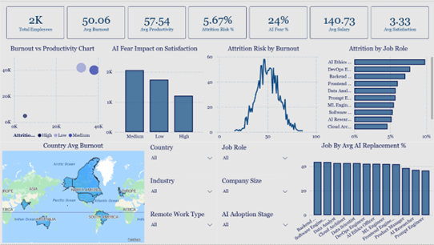
Employee Attrition & AI Impact Dashboard
Dashboard Purpose
This dashboard analyzes employee attrition risk, burnout, productivity, job satisfaction, salary, and AI-related concerns. It helps organizations identify workforce challenges, understand the impact of AI adoption, and improve employee retention strategies.
KPI Cards
Total Employees, Average Burnout Score, Average Productivity Score, Attrition Risk %, AI Fear %, Average Salary, & Average Job Satisfaction
Business Use: Provides a quick overview of workforce performance and employee wellbeing.
Burnout vs Productivity (Bubble Chart)
Shows the relationship between burnout, productivity, and attrition risk levels.
Business Use: Helps identify whether employee burnout affects productivity and retention.
AI Fear Impact on Satisfaction (Bar Chart)
Compares employee satisfaction across different levels of fear of AI replacement.
Business Use: Helps organizations understand how AI-related concerns influence employee morale.
Attrition Risk by Burnout (Line Chart)
Displays the relationship between burnout levels and employee attrition risk.
Business Use: Helps identify burnout thresholds associated with increased turnover risk.
Attrition by Job Role (Bar Chart)
Shows attrition risk distribution across job roles.
Business Use: Helps HR teams identify roles requiring targeted retention strategies.
Country Average Burnout (Map)
Displays average burnout levels across different countries.
Business Use: Supports regional workforce analysis and wellbeing initiatives.
Job Role by Average AI Replacement % (Bar Chart)
Shows the average percentage of tasks employees believe AI can replace within each job role.
Business Use: Helps organizations understand which roles feel most impacted by AI adoption.

Slide 14
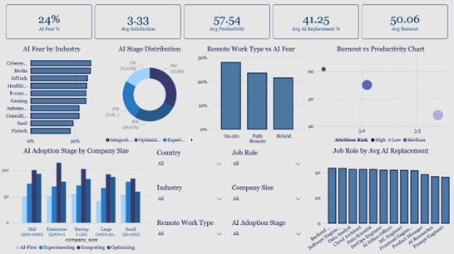
AI Workforce Analytics Dashboard
Dashboard Purpose
This dashboard analyzes the impact of AI adoption on employees across industries, job roles, company sizes, and work environments. It focuses on burnout, productivity, job satisfaction, AI fear, and perceived AI replacement to support workforce planning and business decision-making.
KPI Cards
Displays key workforce indicators including AI Fear %, Average Satisfaction, Average Productivity, Average AI Replacement %, and Average Burnout.
Business Use: Provides a quick overview of employee wellbeing, workforce performance, and AI-related concerns.
AI Fear by Industry (Bar Chart)
Shows the percentage of employees concerned about AI replacement across different industries.
Business Use: Helps organizations identify industries where employees have higher concerns about AI adoption and automation.
AI Adoption Stage Distribution (Donut Chart)
Displays the distribution of organizations across AI adoption stages such as Experimenting, Integrating, and Optimizing.
Business Use: Helps businesses measure AI maturity and monitor digital transformation progress.
Remote Work Type vs AI Fear (Bar Chart)
Compares AI fear levels among On-site, Fully Remote, and Hybrid employees.
Business Use: Helps organizations understand how different work environments influence employee perceptions of AI.
Burnout vs Productivity Chart (Bubble Chart)
Shows the relationship between employee burnout, productivity, and attrition risk levels.
Business Use: Helps identify workforce groups experiencing high burnout and supports employee wellbeing initiatives.
AI Adoption Stage by Company Size (Clustered Bar Chart)
Displays AI adoption stages across different company sizes including startups, small, mid-size, large, and enterprise organizations.
Business Use: Helps compare AI implementation strategies and readiness across organizations of different sizes.
Job Role by Average AI Replacement % (Bar Chart)
Shows the average percentage of tasks employees believe AI can replace for each job role.
Business Use: Helps organizations identify roles most affected by automation and supports workforce reskilling plans.

Slide 15
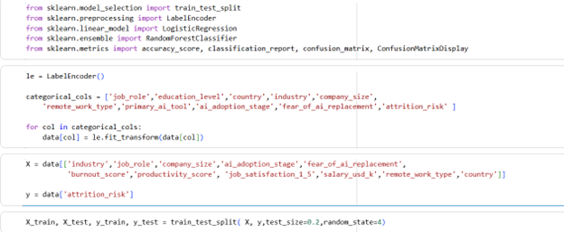
Prediction Model Preparation
Target Variable: Employee Attrition Risk (Low, Medium, High)
Data Encoding: Converted categorical variables into numerical values
Feature Selection: Burnout, Productivity, Satisfaction, Salary, Industry, AI-related factors, etc.
Data Split: 80% Training, 20% Testing
Models Used: Logistic Regression & Random Forest
Evaluation: Accuracy, Precision, Recall, F1-Score, and Confusion Matrix
Outcome: Prepared and optimized the dataset for employee attrition prediction.
Logistic Regression
Classification algorithm used to predict employee attrition risk.
Provides clear and interpretable results.
Serves as a baseline model for comparison.
Random Forest
Ensemble algorithm that combines multiple decision trees.
Captures complex patterns in employee behavior.
Provides higher prediction accuracy and better performance.

Slide 16
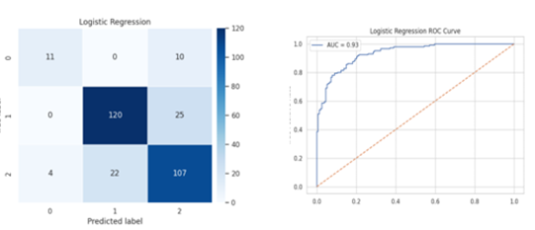
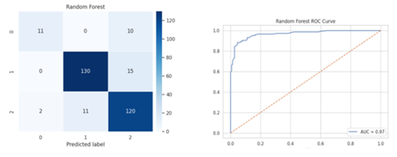
Model Comparison
Logistic Regression
Achieved 80% accuracy in predicting employee attrition risk.
ROC-AUC score of 0.93, indicating strong classification performance.
Performed well in identifying Medium and Low attrition risk employees.
Provides interpretable results, making it easier to understand the impact of workforce factors on attrition.
Random Forest
Achieved 87% accuracy, outperforming Logistic Regression.
ROC-AUC score of 0.97, showing excellent predictive capability.
Higher precision, recall, and F1-scores across most attrition categories.
Better at capturing complex relationships between burnout, satisfaction, productivity, salary, and AI-related factors.
Conclusion
Random Forest was the best-performing model with higher accuracy and stronger overall classification performance.
Metric | Logistic Regression | Random Forest
Accuracy | 80% | 87%
ROC-AUC Score | 0.93 | 0.97
Weighted F1-Score | 0.79 | 0.87
Prediction Performance | Good | Excellent

Slide 17

Overall Business Use
Monitor employee wellbeing, productivity, and AI-related concerns through interactive dashboards.
Predict employee attrition risk using machine learning models to support proactive retention strategies.
Identify key factors influencing turnover, including burnout, job satisfaction, salary, and fear of AI replacement.
Support workforce planning, employee engagement, and AI adoption initiatives.
Enable data-driven HR decisions to improve retention and organizational performance.
Overall Project Conclusion
The project successfully combined Business Intelligence, Machine Learning, and Data Analytics to analyze employee attrition in AI-driven workplaces.
Dashboard analysis revealed important relationships between burnout, productivity, job satisfaction, AI fear, and attrition risk.
Predictive models accurately identified employees at different attrition risk levels, with Random Forest achieving the best performance (87% accuracy).
The findings showed that burnout, low job satisfaction, and AI replacement concerns significantly influence employee retention.
Overall, the project demonstrates how data analytics and AI techniques can help organizations improve workforce planning, employee wellbeing, and retention strategies through data-driven decision-making.

